Slide 1

Lecture 7 Cyber Security Essentials 20CYS114
-Saurabh Shrivastava
TIFAC Core in Cyber Security
Amrita Vishwa Vidyapeetham

Slide 2
DNS (Domain Name System)
It’s a system that lets you connect to websites by matching human-readable domain names (like google.com) with the unique ID of the server where a website is stored.
DNS or Domain Name System basically translates the domain names into IP addresses and points your device in the right direction.
A domain name and its matching IP address is called a “DNS record”.

Slide 3
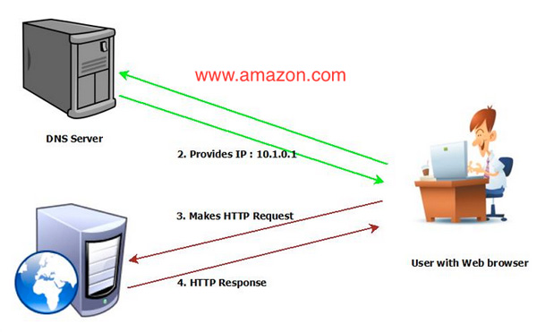
DNS working

Slide 4
DNS Hierarchy
Root DNS Server
TLD DNS Server
Authoritative DNS Server

Slide 5
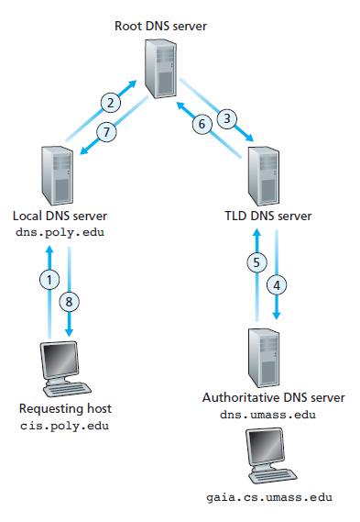
Iterative

Slide 6
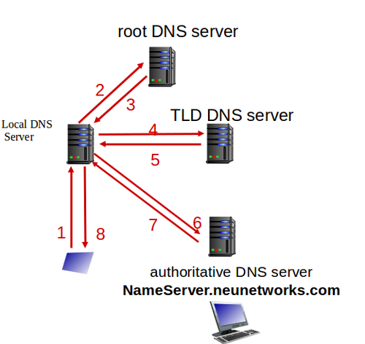
Recursive

Slide 7
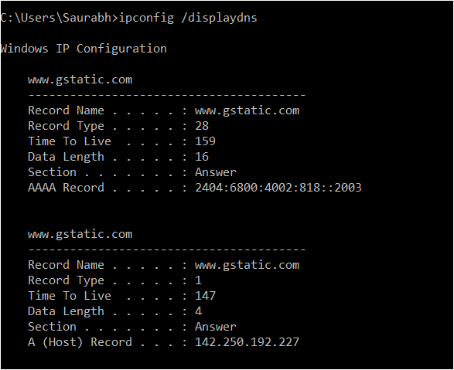
Local DNS

Slide 8
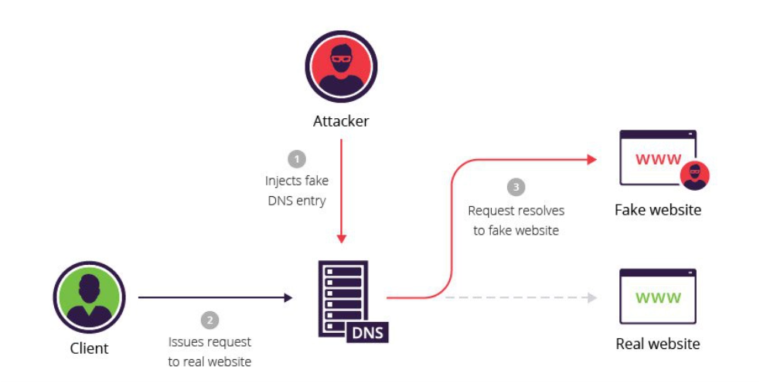
DNS Spoofing or DNS cache poisoning

Slide 9
ARP
ARP works between network layers 2 and 3 of the OSI model.
It translate 32-bit addresses to 48-bit addresses and vice-versa.
When an incoming packet destined for a host machine on a particular LAN arrives at a gateway, the gateway asks the ARP program to find a MAC address that matches the IP address.
A table called the ARP cache maintains a record of each IP address and its corresponding MAC address.

Slide 10
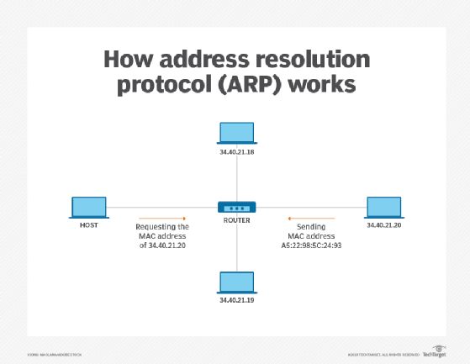
ARP

Slide 11
ARP Spoofing or ARP cache poisoning
ARP spoofing is a device attack in which a hacker broadcasts false ARP messages over a LAN in order to link an attacker's MAC address with the IP address of a legitimate computer or server within the network.
Once a link has been established, the target computer can send frames meant for the original destination to the hacker's computer first as well as any data meant for the legitimate IP address.

Slide 12
ARP Spoofing or ARP cache poisoning
Add Static ARP Entry
arp -s 192.168.122.50 00-aa-00-62-c6-09
Remove ARP Entry
arp -d 192.168.122.50

Slide 13
Wi-Fi Attack
An evil twin is a fraudulent Wi-Fi access point that appears to be legitimate but is set up to eavesdrop on wireless communications.
The attacker snoops on Internet traffic using a bogus wireless access point.
The evil twin is the wireless LAN equivalent of the phishing scam.
This type of attack may be used to steal the passwords of unsuspecting users, either by monitoring their connections or by phishing, which involves setting up a fraudulent web site and luring people there.

Slide 14
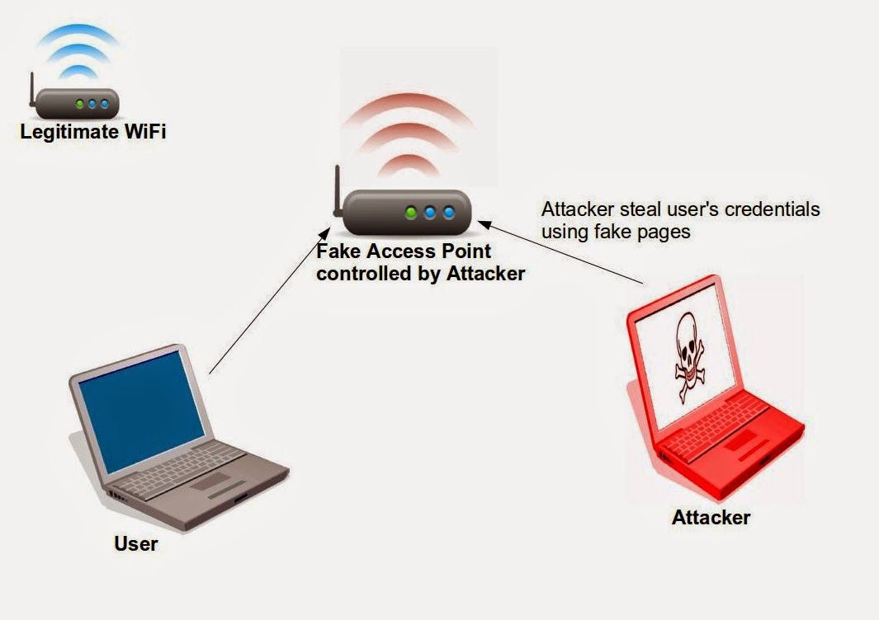
Evil Twin Attack

Slide 15
References:
https://www.wpbeginner.com/glossary/dns/
https://www.cloudflare.com/en-in/learning/dns/what-is-dns/
https://www.imperva.com/learn/application-security/dns-spoofing/
https://searchnetworking.techtarget.com/definition/Address-Resolution-Protocol-ARP
https://en.wikipedia.org/wiki/Evil_twin_(wireless_networks)

